Slide 1
Scheduling randomly-deployed heterogeneous video sensor nodes for reduced intrusion detection time
ICDCN, 2011
Infosys Campus, Bangalore, India
Monday, January 3rd
Prof. Congduc Pham
http://www.univ-pau.fr/~cpham
Université de Pau, France
Notes:
My bio, the project…
Where to find the latest version of the slides in electronic format
Don’t hesitate to interrupt me
Break at 4pm

Slide 2
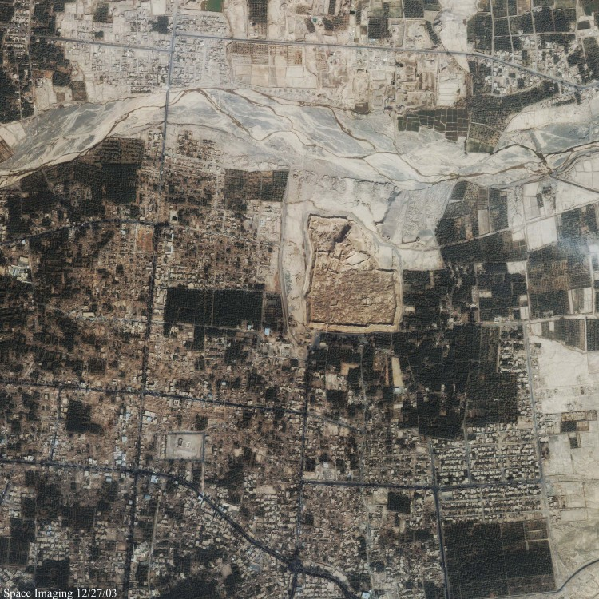
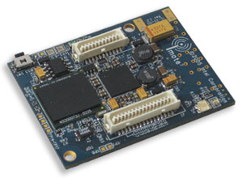
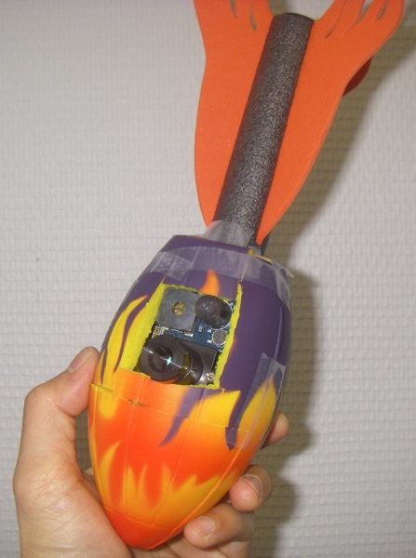
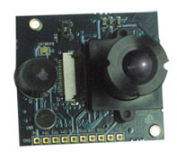
Wireless Video Sensors
Imote2
Multimedia board

Slide 3
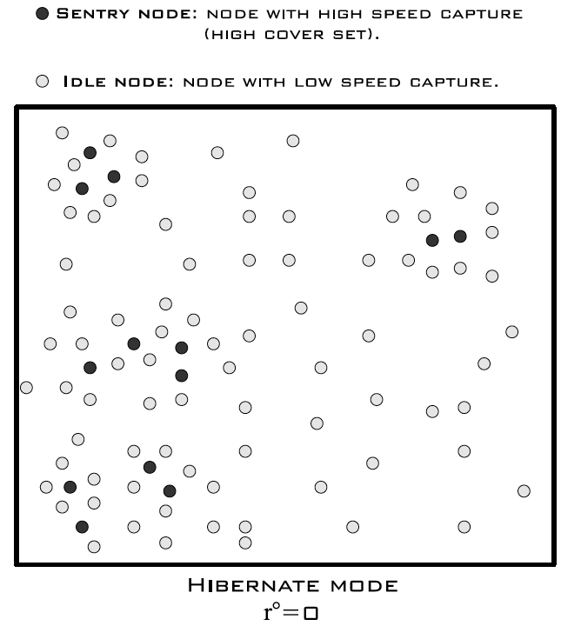
Surveillance scenario (1)
Randomly deployed video sensors
Not only barrier coverage but general intrusion detection
Most of the time, network in so-called hibernate mode
Most of active sensor nodes in idle mode with low capture speed
Sentry nodes with higher capture speed to quickly detect intrusions

Slide 4
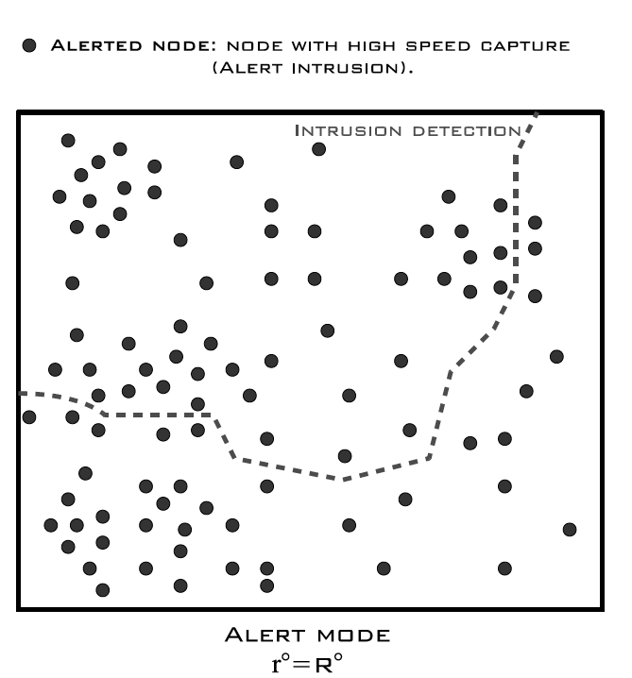
Surveillance scenario (2)
Nodes detecting intrusion must alert the rest of the network
1-hop to k-hop alert
Network in so-called alerted mode
Capture speed must be increased
Ressources should be focused on making tracking of intruders easier

Slide 5
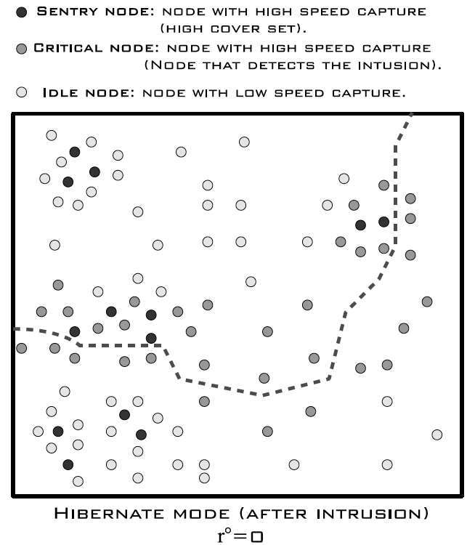
Surveillance scenario (3)
Network should go back to hibernate mode
Nodes on the intrusion path must keep a high capture speed
Sentry nodes with higher capture speed to quickly detect intrusions

Slide 6
Don’t miss important events!
Real scene
Whole understanding of the scene is wrong!!!
What is captured

Slide 7
How to meet surveillance app’s criticality
Capture speed can be a « quality » parameter
Capture speed for node v should depend on the app’s criticality and on the level of redundancy for node v
Note that capturing an image does not mean transmitting it
V’s capture speed can increase when as V has more nodes covering its own FoV - coverset

Slide 8
Redundancy Node’s cover set
Each node v has a Field of View, FoV_{v}
Co_{i}(v) = set of nodes v’ such as ∪_{v’∈Coi(v)}FoV_{v’} covers FoV_{v}
Co(v)= set of Co_{i}(v)
V₂
V₁
V₄
V
V₃
Co(v)={V₁,V₂,V₃,V₄}

Slide 9
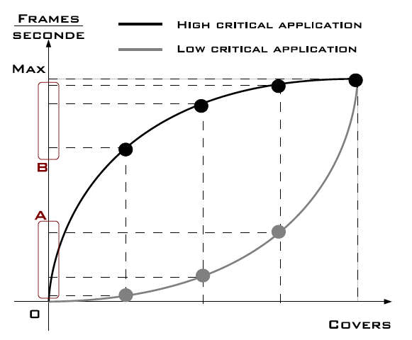
Criticality model (1)
Link the capture rate to the size of the coverset
High criticality
Convex shape
Most projections of x are close to the max capture speed
Low criticality
Concave shape
Most projections of x are close to the min capture speed
Concave and convex shapes automatically define sentry nodes in the network

Slide 10
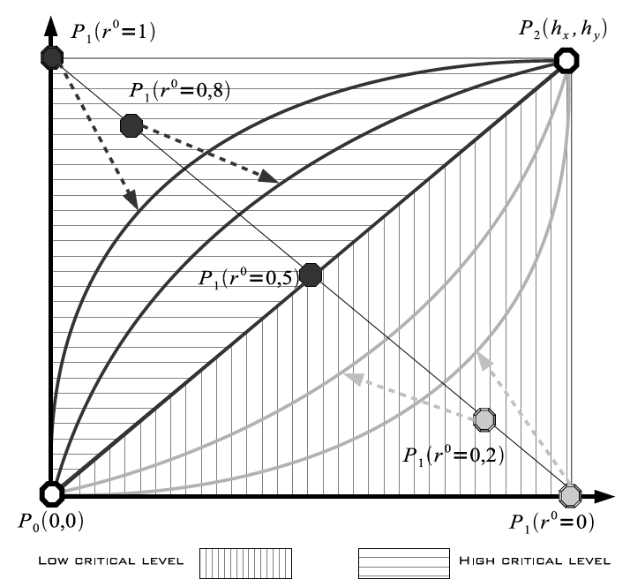
Criticality model (2)
r⁰ can vary in [0,1]
BehaVior functions (BV) defines the capture speed according to r⁰
r⁰ < 0.5
Concave shape BV
r⁰ > 0.5
Convex shape BV
We propose to use Bezier curves to model BV functions

Slide 11
Some typical capture speed
Set maximum capture speed: 6fps or 12fps
Nodes with coverset size greater than N capture at the maximum speed
N=6
P₂(6,6)
N=12
P₂(12,3)

Slide 12
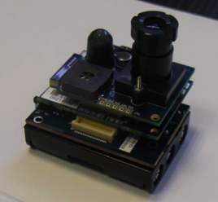
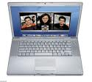
Finding v’s cover set
P = {v ∈ N(V ) : v covers the point “p” of the FoV}
B = {v ∈ N(V ) : v covers the point “b” of the FoV}
C = {v ∈ N(V ) : v covers the point “c” of the FoV}
G = {v ∈ N(V ) : v covers the point “g” of the FoV}
c
v
b
AoV=20°
v₁
v
α
c
b
2α=AoV
g
v₅
p
v₂
AoV=38°
v₄
p
v₆
2α=30°
v₃
PG={P∩G}
BG={B∩G}
CG={C∩G}
Co(v)=PG×BG×CG
AoV=31°

Slide 13
Large Angle of View
v₁
v₁
c
b
c
b
g
v₅
g
v₅
v₂
v₂
Co(V)= {
{V },
{V₁, V₄, V₆},
{V₄, V₅, V₆}
}
v₄
v₄
p
p
v₆
v₆
2α=60°
v₃
2α=60°
v₃

Slide 14
Large Angle of View
v₁
v₁
c
b
c
b
g
v₅
g
v₅
v₂
v₂
Co(V)= {
{V },
{V₁, V₄, V₆},
{V₄, V₅, V₆}
}
v₄
v₄
p
p
v₆
v₆
2α=60°
v₃
2α=60°
v₃

Slide 15
Small Angle of View
v₁
v₁
c
b
c
b
Co(V)= {V}
g_{v}
Co(V)= {
{V },
{V₁, V₃, V₄},
{V₂, V₃, V₄},
{V₃, V₄, V₅},
{V₁, V₄, V₆},
{V₂, V₄, V₆},
{V₄, V₅, V₆}
}
g
v₅
g
v₅
v₂
v₂
g_{p}
v₄
v₄
p
p
v₆
v₆
2α=30°
v₃
v₃
PG={P∩g_{p}}
BG={B∩g_{v}}
CG={C∩g_{v}}
Co(v)=PG×BG×CG

Slide 16
v₁
v₁
v₁
c
b
c
b
c
b
g_{v}
g_{v}
g_{v}
g
v₅
g
v₅
g
v₅
v₂
g_{p}
v₂
g_{p}
v₂
g_{p}
v₄
v₄
v₄
p
p
p
{V₁, V₃, V₄}
v₆
{V₂, V₃, V₄}
v₆
{V₃, V₄, V₅}
v₆
v₃
v₃
v₃
v₁
v₁
v₁
c
b
c
b
c
b
g_{v}
g_{v}
g_{v}
g
v₅
g
v₅
g
v₅
v₂
g_{p}
v₂
g_{p}
v₂
g_{p}
v₄
v₄
v₄
p
p
p
{V₁, V₄, V₆}
v₆
{V₂, V₄, V₆}
v₆
{V₄, V₅, V₆}
v₆
v₃
v₃
v₃

Slide 17
Heterogeneous AoV
v₁
c
b
v₁
c
g_{v}
b
g
v₅
v₂
g
v₅
g_{p}
v₂
v₄
v₄
p
v₆
v₁
v₆
v₁
c
b
v₃
c
b
g_{c}
g_{b}
v₃
g
v₅
g
v₅
v₂
v₂
g_{p}
v₄
v₄
v₆
v₆
v₃
v₃

Slide 18
Very Small Angle of View
2α=30°
2α=20°
v₁
v₁
c
b
c
b
g_{c}
g_{c}
g_{b}
Co(V)= {
{V },
{V₁, V₃, V₄},
{V₂, V₃, V₄},
{V₃, V₄, V₅},
{V₁, V₄, V₆},
{V₂, V₄, V₆},
{V₄, V₅, V₆}
}
g_{b}
g
v₅
g
v₅
v₂
v₂
g_{p}
g_{p}
v₄
v₄
Co(V)= {
{V },
{V₁, V₃, V₄},
{V₂, V₃, V₄},
{V₃, V₄, V₅},
{V₁, V₄, V₆},
{V₂, V₄, V₆},
{V₄, V₅, V₆}
}
p
p
v₆
v₆
v₃
v₃
PG={P∩g_{p}}
BG={B∩g_{b}}
CG={C∩g_{c}}
Co(v)=PG×BG×CG

Slide 19
Very Small Angle of View
2α=30°
2α=20°
v₁
v₁
c
b
c
b
g_{c}
g_{c}
g_{b}
Co(V)= {
{V },
{V₁, V₃, V₄},
{V₂, V₃, V₄},
{V₃, V₄, V₅},
{V₁, V₄, V₆},
{V₂, V₄, V₆},
{V₄, V₅, V₆}
}
g_{b}
g
v₅
g
v₅
v₂
v₂
g_{p}
g_{p}
v₄
v₄
Co(V)= {
{V },
{V₁, V₃, V₄},
{V₂, V₃, V₄},
{V₃, V₄, V₅},
{V₁, V₄, V₆},
{V₂, V₄, V₆},
{V₄, V₅, V₆}
}
p
p
v₆
v₆
v₃
v₃
PG={P∩g_{p}} l {g_{p}}
BG={B∩g_{b}} l {g∩g_{b}}
CG={C∩g_{c}} l {g∩g_{c}}
Co(v)=PG×BG×CG

Slide 20
Comparison of cover-set strategies
b
p
c
b
g
p
c
b
p
c
b

p
c

Slide 21
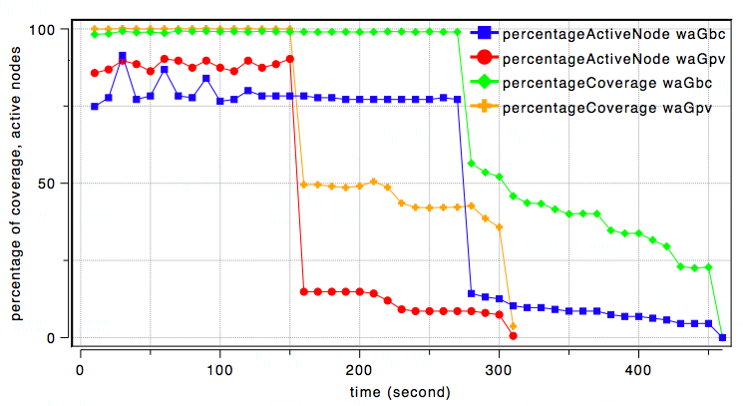
%coverage, %active nodes CO_{pbcApv} vs CO_{pbcApbc}
CO_{pbcApbc} provides a higher network lifetime while maintaining a %coverage close to the CO_{pbcApv} strategy

Slide 22
Implementation issues

Slide 23
Simulation settings
OMNET++ simulation model
Video nodes have communication range of 30m and depth of view of 25m, AoV is 36°. 150 sensors in an 75m.75m area.
Battery has 100 units, 1 image = 1 unit of battery consumed.
Max capture rate is 3fps. 12 levels of cover set.
Full coverage is defined as the region initially covered when all nodes are active

Slide 24
mean stealth time
t₁-t₀ is the intruder’s stealth time
velocity is set to 5m/s
t₀
t₁
intrusions starts at t=10s
when an intruder is seen, computes the stealth time, and starts a new intrusion until end of simulation

Slide 25
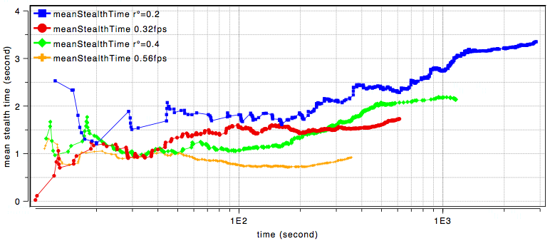
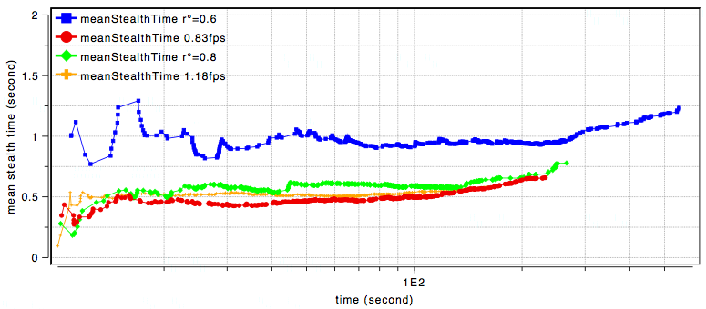
mean stealth time
600s
3000s

Slide 26
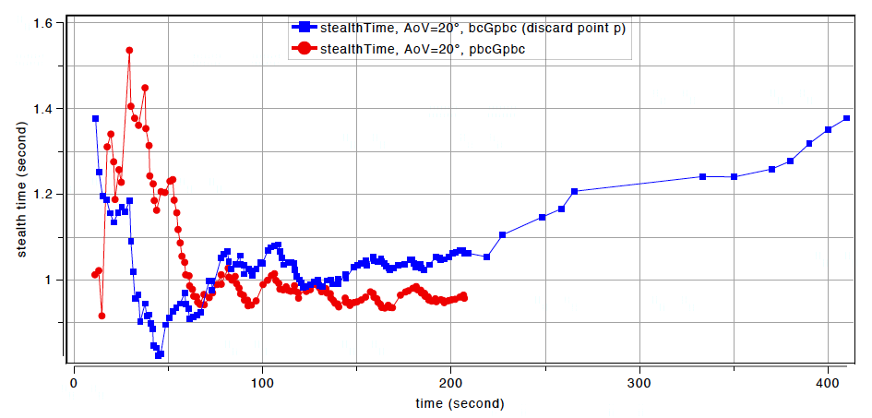
Very small AoV

Slide 27
Occlusions/Disambiguation
8m.4m rectangle➔grouped intrusions
v₁
v₁
c
b
c
b
g
v₅
g
v₅
v₂
v₂
v₄
v₄
p
p
v₆
v₆
v₃
v₃
Multiple viewpoints are desirable
Some cover-sets « see » more points than other

Slide 28
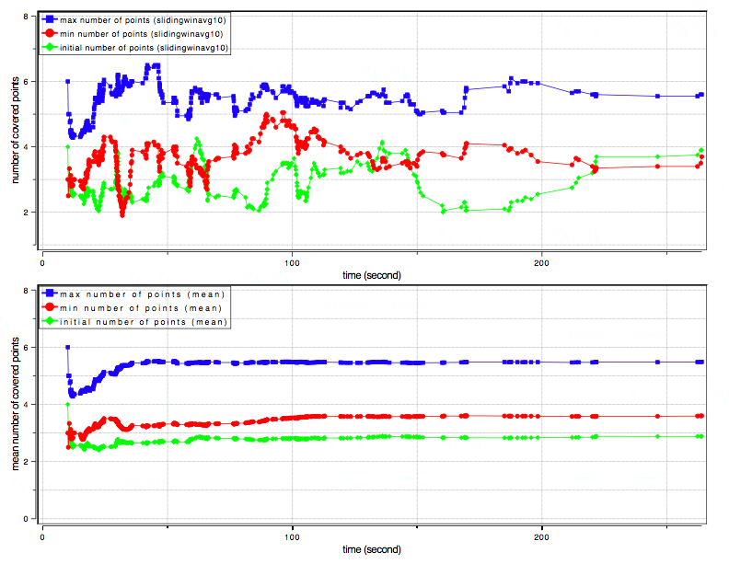
Occlusions/Disambiguation (2)
Sliding winavg of 10
Intrusion starts at t=10s
Velocity of 5m/s
Scan line (left to right)
CO_{pbcApbc}
Mean

Slide 29
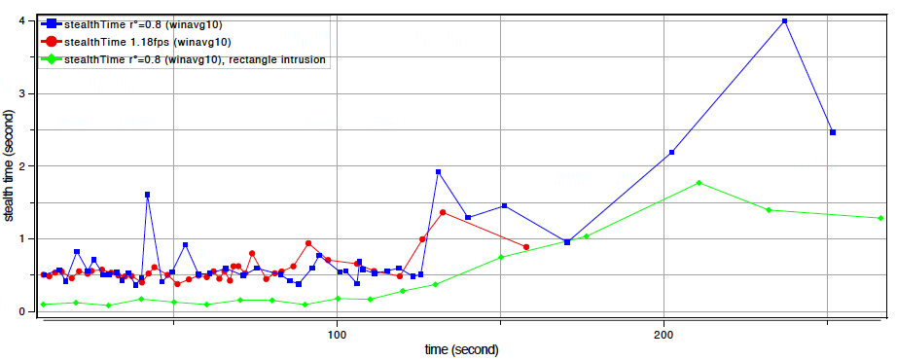
Occlusions/Disambiguation (3)

Slide 30
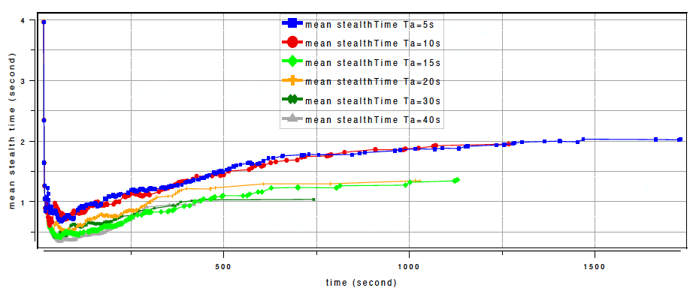
Dynamic criticality mngt
Sensor nodes start at 0.1 then increase to 0.8 if alerted (by intruders or neighbors) and stay alerted for Ta seconds

Slide 31
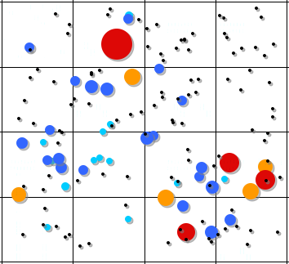
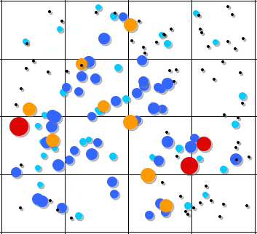
Sentry nodes
# of cover sets
# intrusion detected
0
<5
<10
<15
>15
0
<5
<10
<15
>15

Slide 32
Conclusions
Models the application’s criticlity and schedules the video node capture rate accordingly
Simple method for cover-set computation for video sensor node that takes into account small AoV and AoV heterogeneity
Used jointly with a criticality-based scheduling, can increase the network lifetime while maintaining a high level of service (mean stealth time)

